Slide 1
Capstone Project

Slide 2
Introduction
ABC is a company based in Toronto for organizing events, currently it works on a project to organize an event for 5 days for a group of photographers from all over the world.The company has to put a good program, including a hotel of residence, a hall for meetings, places of landscape to visit, stores for shopping, restaurants and cafes. So the company’s purpose is to make a list of places of landscape in Toronto, including the nearest restaurants, cafes, and shopping stores for each place

Slide 3
Data
The data used in this project is provided by Foursquare location data. The data are grouped by landscape area, and each area included the information about this area and all information about restaurants, cafes, and stores which in this area.

Slide 4
Methodology
Basic skills from week 3 lab
Majorly relied on Foursquare API

Slide 5
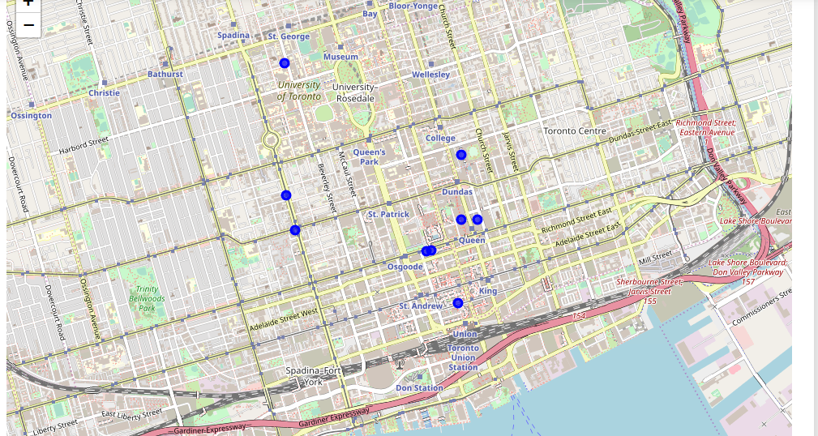
Results : Hotel Map

Slide 6
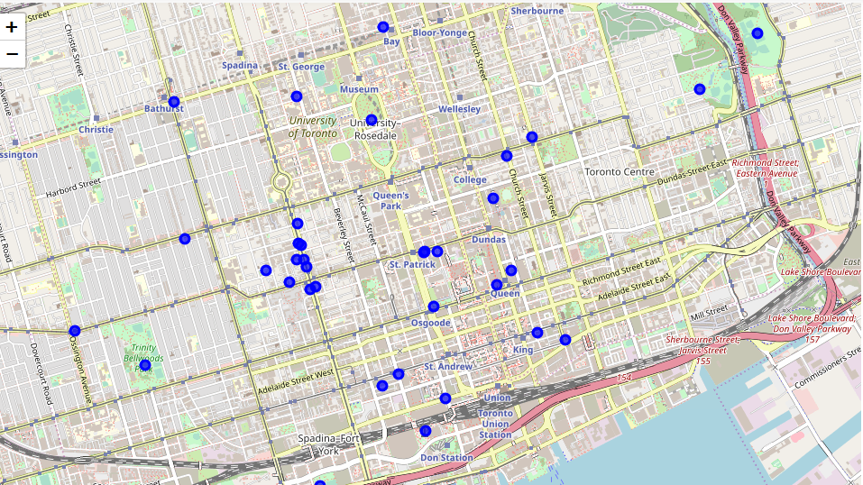
Results : Park Map

